Slide 1
Creativity
By :
Miss Mandeep Kaur
Assistant Prof.

Slide 2
Creativity
Creativity can best be defined as original thinking, new types of associations, divergent thinking and behavior, new solution of old problems, seeing or expressing new relationships, flexibility and new approach in different fields of life.
Ruch :- “ those who show originality and ability to integrate the elements of a situation into a harmonious whole- whether as a parents, a doctor or a football players- are leading creative lives.
Skinner :- Creative thinking means that “ the predictions and/or inferences for the individual are new original, ingenious, unusual. The creative thinker is one who explores new area and makes new observations, new predictions and new interferance.

Slide 3
TECHNIQUES OF FOSTERING CREATIVITY BRAIN STORMING
Brain Storming Technique for fostering new ideas had been developed by Osborn in 1963. it involves storming of creative problem, it is a technique which emphasises the importance of divergent thinking. Has two types of mental activities :
1. Creative Mind
2. Judicial Mind

Slide 4
View of Page and Thomas : Brain Storming Technique of exploring possible solution wherein participants are encouraged to contribute suggestions without risk of ridicule.

Slide 5
Characteristics of Brain Storming Techniques
Simple and specific problem
Encouragement
Spontaneity of ideas
Modification of Ideas
Chain thinking
Compitition
No criticism
No evaluation

Slide 6
Principles of brain Storming
Statement of Problem
Encouragement
Appreciation
No criticism
Central Point
Chairman & Recorder
Responsibilities
Discussion

Slide 7
Usage of Brain Storming
Arousal of attention
Development of interest
Development of imagination
development of ideas
Finding solution
Joy and satisfaction

Slide 8
Problem solving method
Problem solving is an important technique of developing creativity among students. The success happiness and efficiency in life to a great extent depend upon problem solving and creativity.

Slide 9
Characteristics of a Good Problem
Real
Educational significant
Interesting and practical
Clear and definite
Pupil Centered
Thought Provoking
Possible of Solution

Slide 10
Merits of Problem Solving Techniques
Self Expression
Self Discipline
Thinking and reasoning
Critical judgment
Study Habits
New Idea and Knowledge
Interest and Enthusiasm

Slide 11
Role of Teacher in Problem Solving Techniques
Creating problem Situation
Sensing the problem
Problem of the whole class
Providing motivation
Providing assistance
Encouraging divergent thinking
Conclusion

Slide 12
Group discussion as a method of developing creativity
Creativity can be developed among students with the help of group discussion. Convergent as well as divergent thinking is involved in group discussion.
There are various type of group discussion
Informal Discussion
Formalized discussion
Panel or round table discussion
The symposium discussion
The seminar discussion
The workshop discussion

Slide 13
Advantages of Group Discussion
Oral Expression
Logical & original Thinking
Self Confidence
Organization of Ideas
Co-operative work
Social adaptebilty

Slide 14
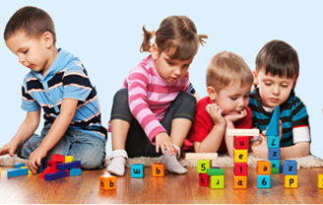
Play way Method
Playway method is another important method for developing creativity among the students. Its stimulates thinking , reasoning, imagination and problem solving.

Slide 15
Forms of Play Way
Kindergarten method
Montessori Method
Dalton plan
Basic system of education
Project Method
Heuristic method
Story method
Self governments
Scouting , girl guides, NCC etc.
Dramatisation and chorus singing
Intellectual games
Hobbies
Co-corricular activities
Audio Visual Aids

Slide 16
Uses of Play way
Intellectual Uses
New Idea and thoughts
Thinking and reasoning
Mental horizon
Imagination
Judgment
Learning by doing
Emotional uses
Social uses
Physical Uses
Personality importance
Therapeutic Importance
Conclusion

Slide 17
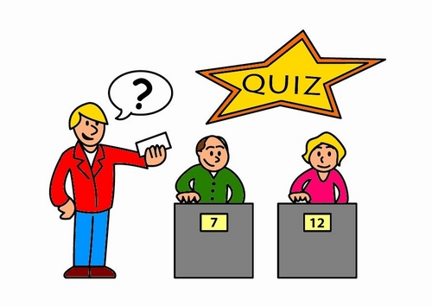
Quiz
Quiz is a unique method of developing creativity among students. Its entails putting questions to a group regarding various issues or a particular theme. The person responsible for asking questions to the participants in a quiz should be mature and experienced person. He should be embodiment of knowledge.

Slide 18
Advantages of quiz
Mental horizon
Reading Habits
Clear thinking
Self confidence and boldness
Planning and organization
Instinctive Value
Emotional Value

Slide 19
Role of Teacher in Organizing Quiz
Proper Planning
Preparations and guidance

